Slide 1
ASE 456: Project Presentation Power Ranger: Calculator
By: Brooks Arthur, Amaya Bryant, Spencer Yates, Prosper Jibunor

Slide 2
Feature Overview
Scientific Functions
Advanced Functions
Unit Conversion
Money Conversion
Color Picker
Delete Functionality

Slide 3

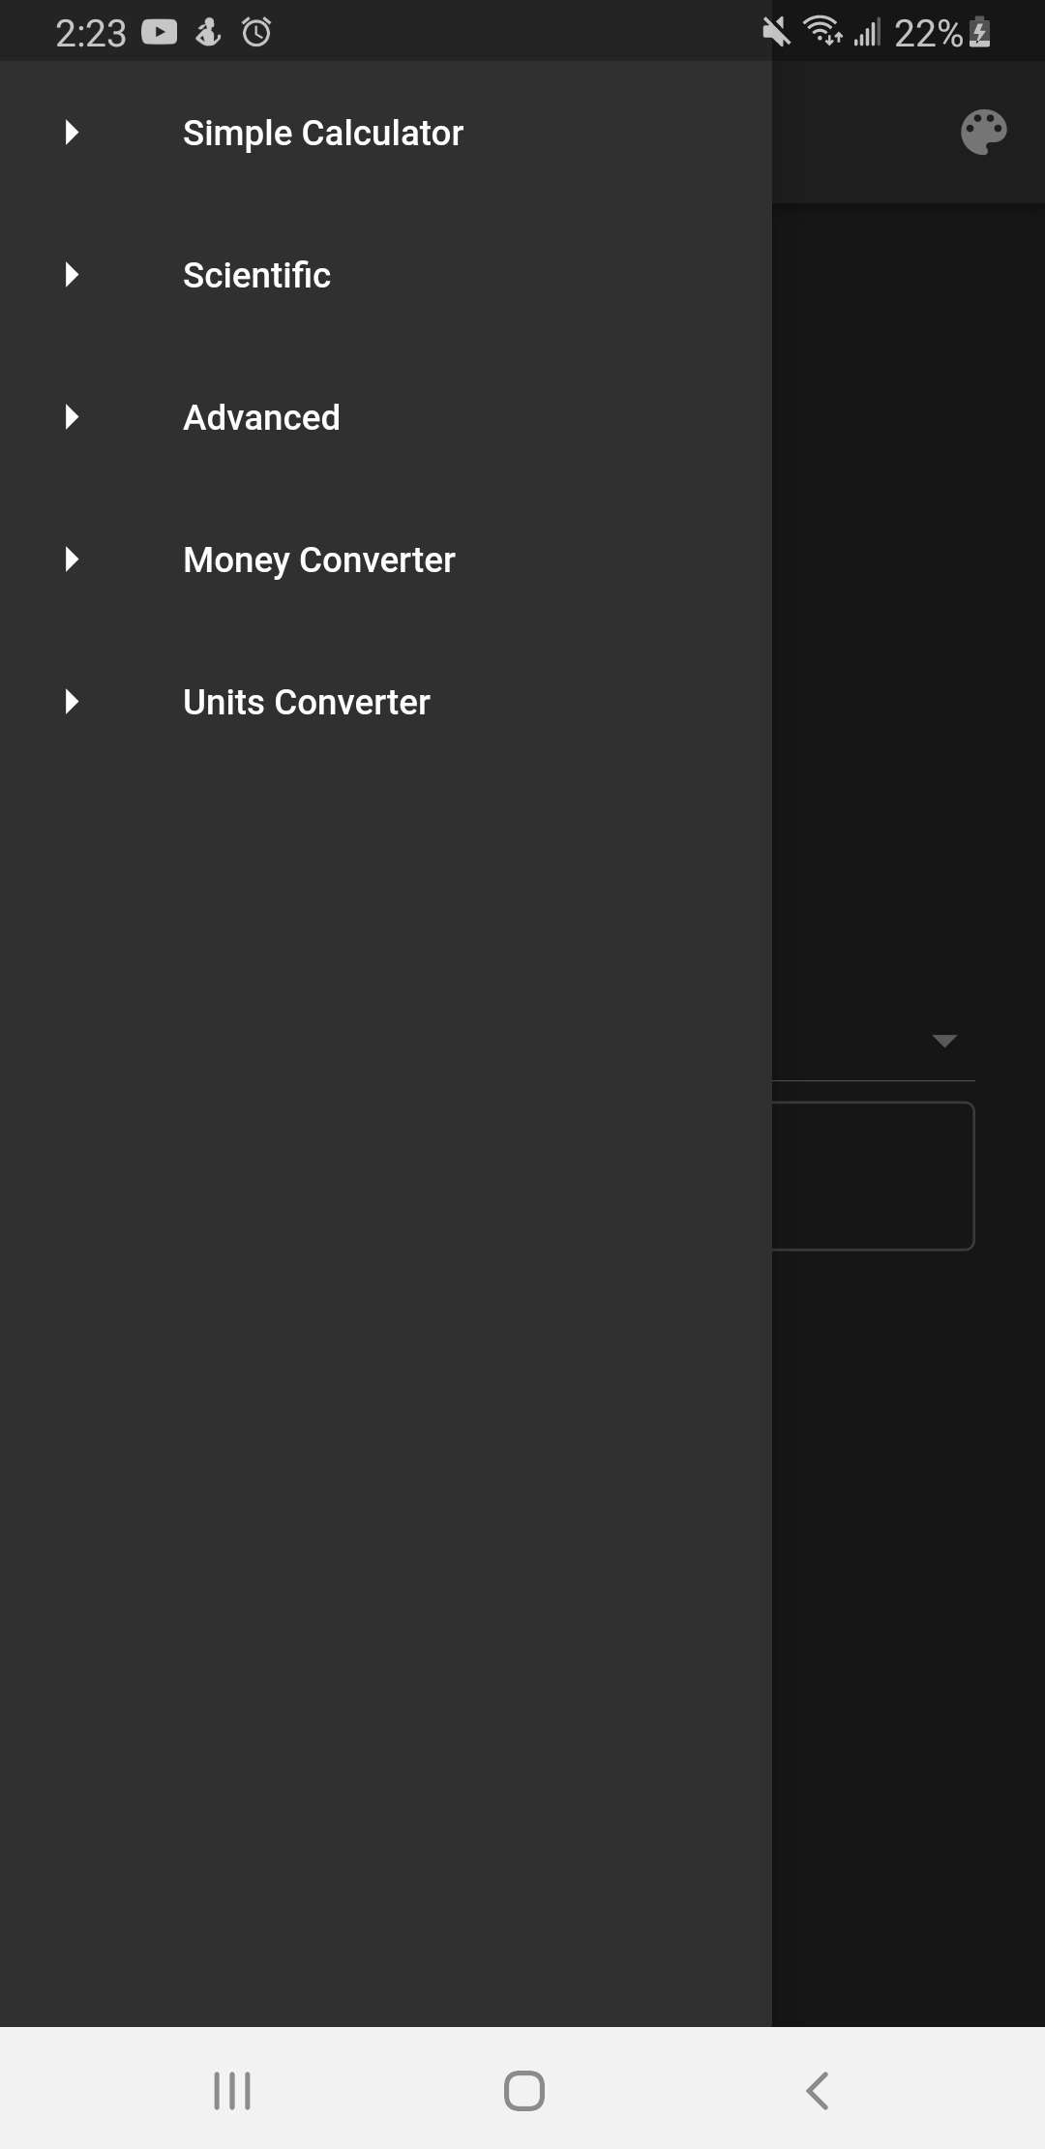

Slide 4
Basic Functionality
User can input numbers and decimals
Allows user to add, subtract, multiple, and divide
User can access side bar to access additional features as needed

Slide 5
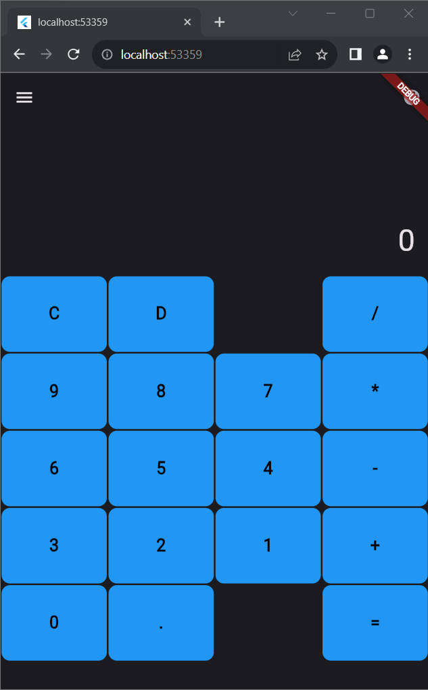
Basic Calculator
Allows for all functions found in standard adding, subtraction, multiplication, and division calculators

Slide 6
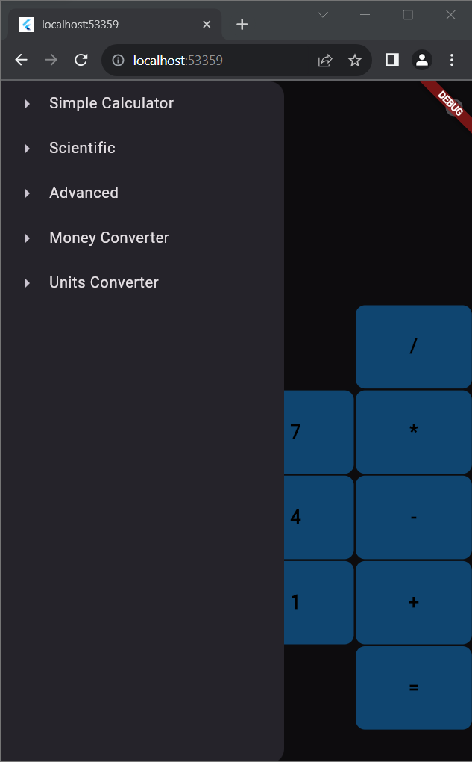
Menu Side-Bar
Allows for seamless transitions between all screens

Slide 7
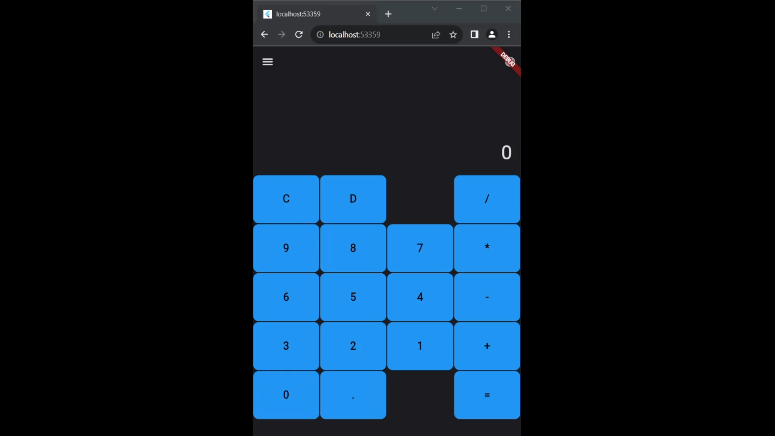
Color Picker and Delete Functionality
Color Picker
Delete Functionality
Allows for users to select a color and alter the color of all buttons found in the application.
Allows for all primary calculator functions to delete inputs.

Slide 8
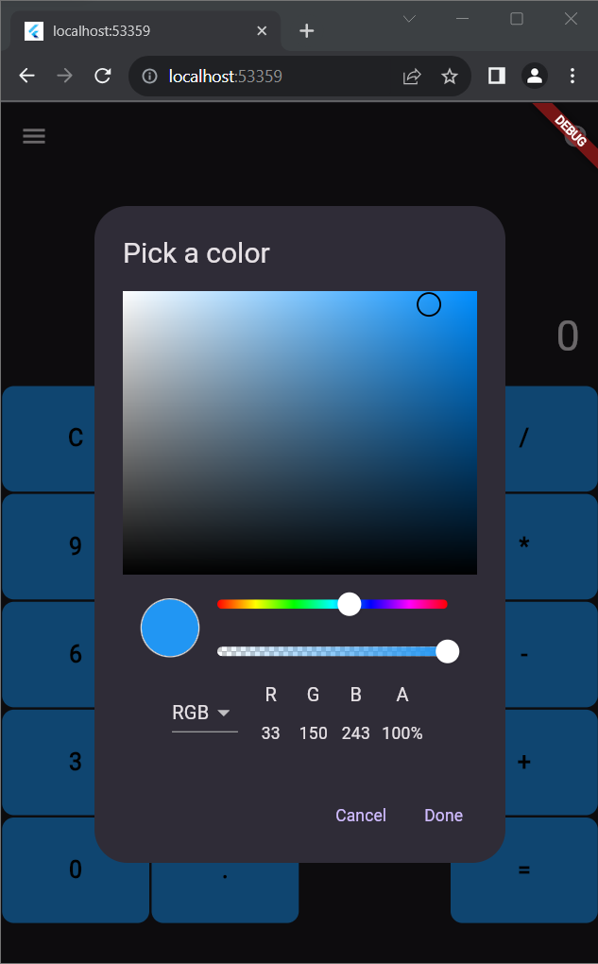
Color Picker
Gives users the ability to select colors from a color pallet or by inputting the specific RGBA values.

Slide 9

Delete Functionality
Allows the user to delete inputs via the pressing of a clearly labeled button.

Slide 10
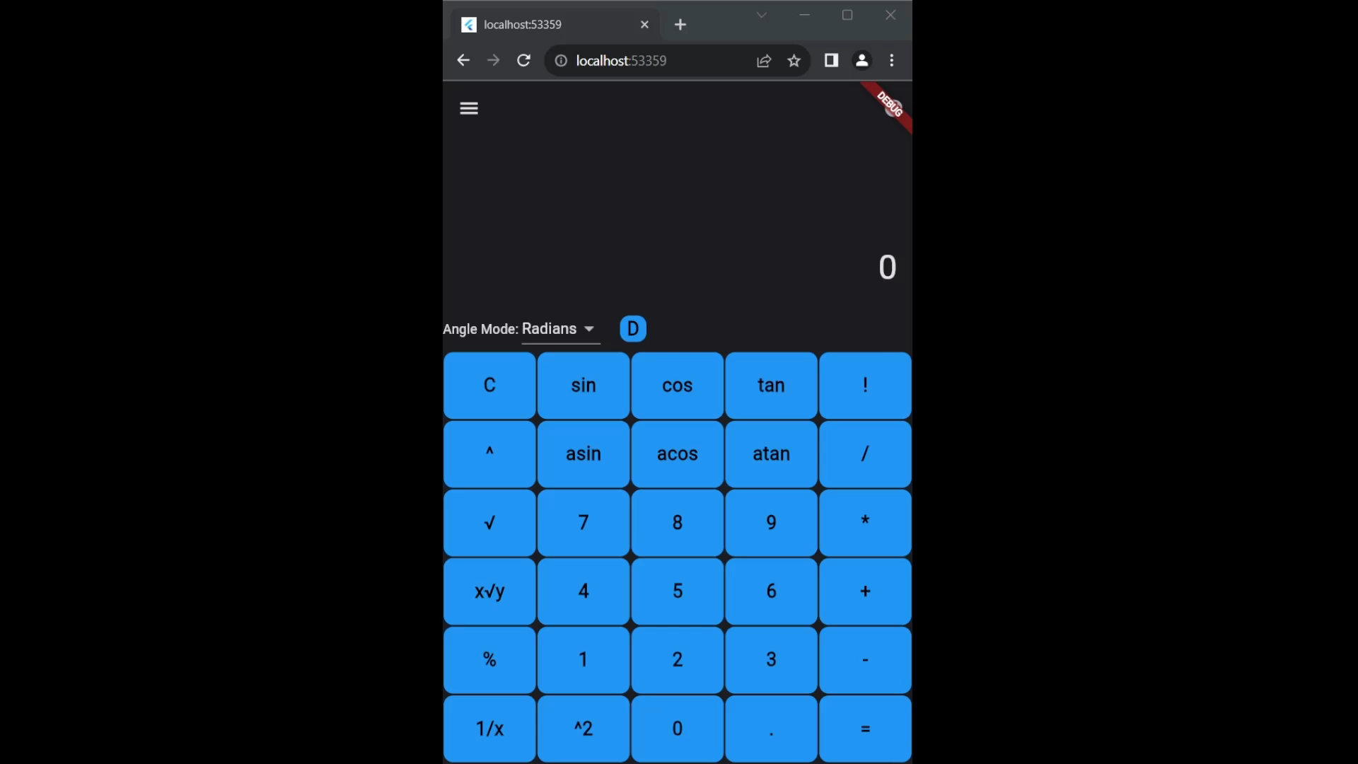
Advanced and Scientific Calculator
Scientific calculator allows users to access scientific functions. Ex: trigonometric functions, factorials, powers, and more
Advanced calculator allows users to access more advanced features than what is normally present in a calculator. Ex: log, negative numbers, constants, and more.

Slide 11
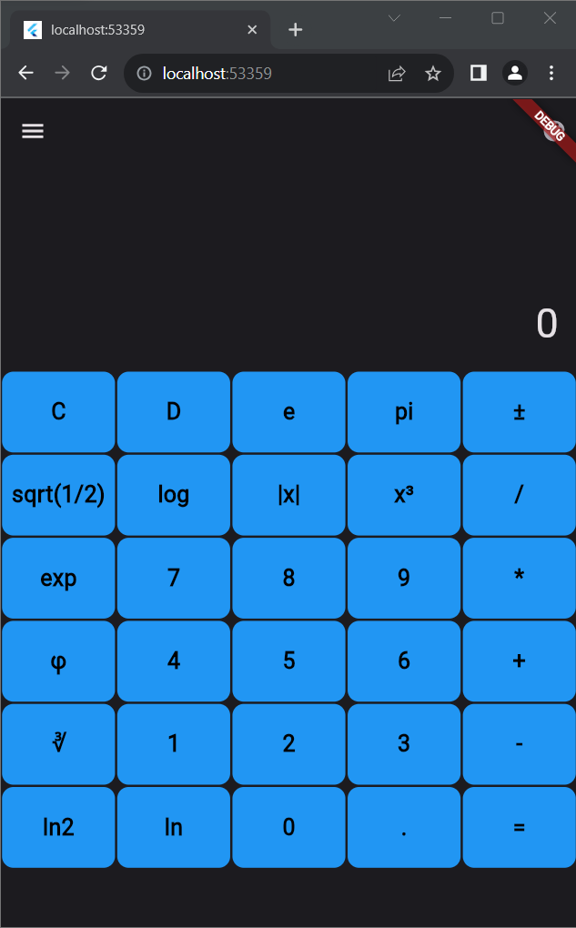
Advanced Functions
List of Functions:
e, pi, and ϕ constats.
Negative numbers and absolute value.
Exponentiation.
Radicals.
Natural logarithms.

Slide 12
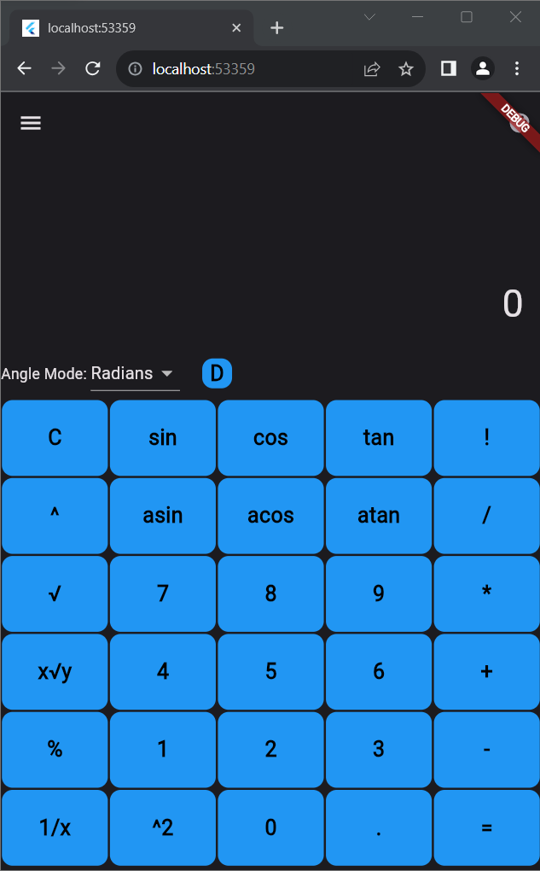
Advanced Functions
List of Functions:
Trigonometric functions.
Angle modes.
Factorials.
Expanded exponentiation and radical mathematics.

Slide 13
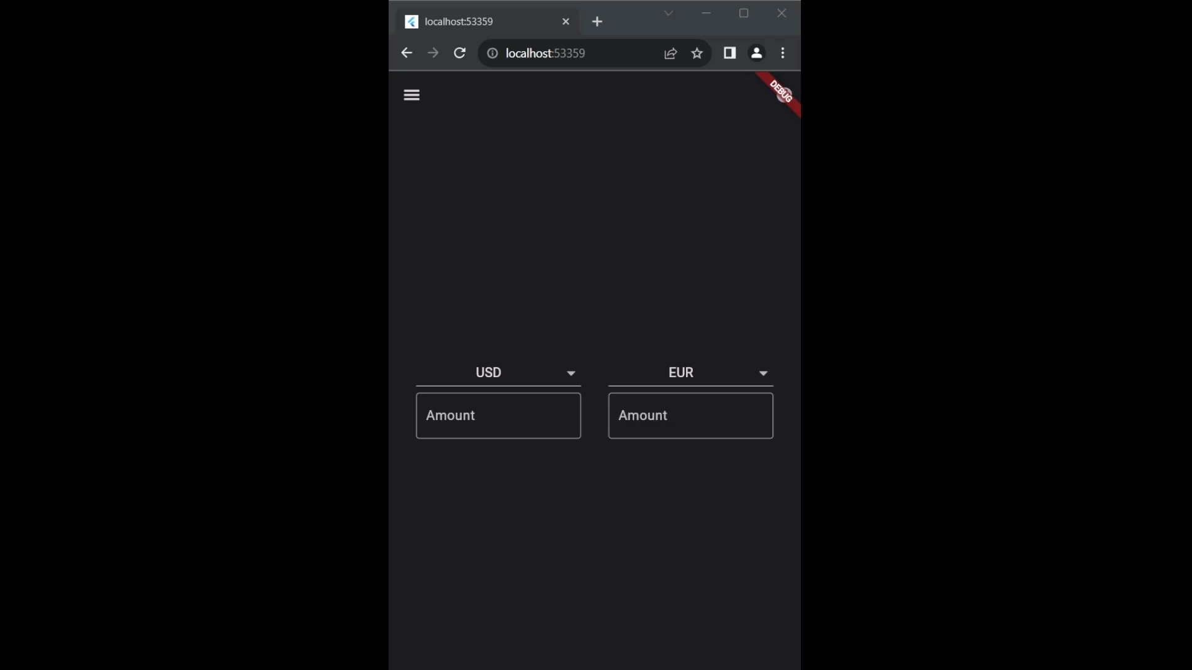
Money and Unit Conversion
Allows for conversion between numerous different measuring units.
Allows for accurate and updated conversions between most major currencies.

Slide 14
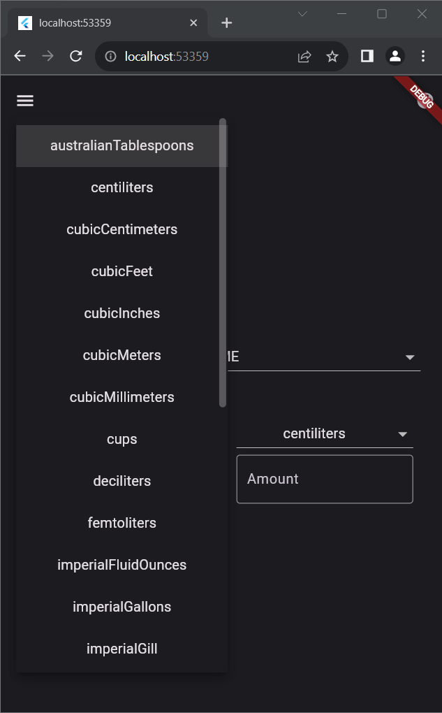
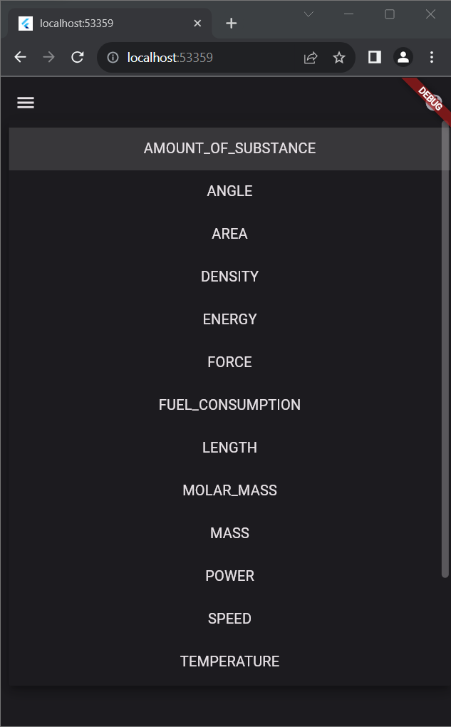
Unit Converison
Provides 16 categories of units to convert.
Proves the user with 180 different units to within those categories.

Slide 15
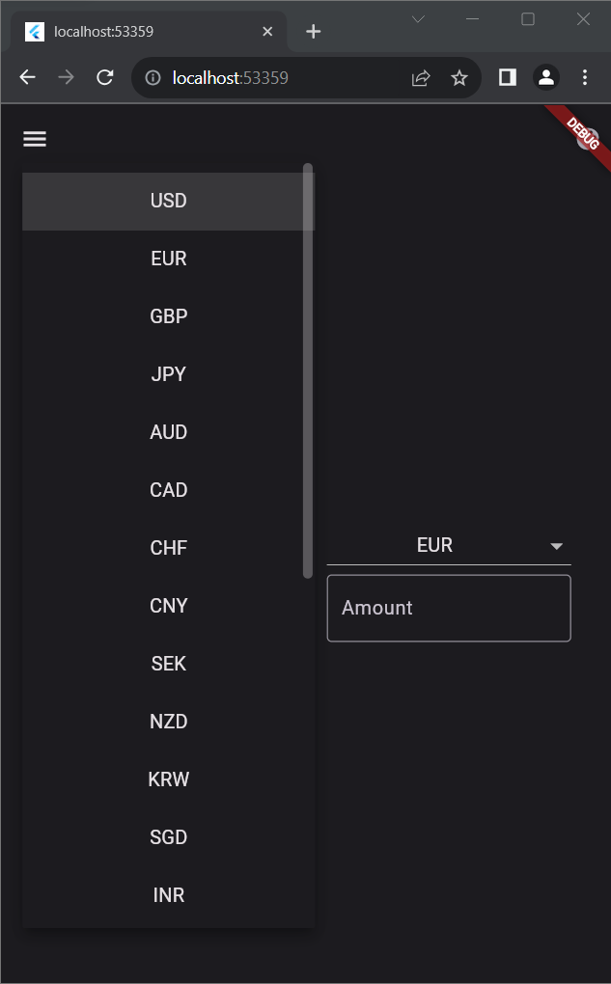
Money Conversion
Makes use of the “currconv.com” API to get up-to-date and accurate conversions.
Allows for conversions between the 24 most widely used currencies.

Slide 16
Total Lines of Code Breakdown: 3,145 Lines
Scientific Functions: 551
Advanced Functions: 338
Unit Conversion: 154
Money Conversion: 166
Units List: 461
Button UI: 39
Color Picker UI: 56
Tests: 1037
Other Files: 343

Slide 17
Testing Breakdown
58 tests were completed
31 scientific and advanced functions tests
17 unit conversion and money conversion tests
2 color picker and delete functionality tests
58 tests passed
7 integration/regression tests
1 acceptance test

Slide 18
What We Learned
How to program in Dart using Flutter.
How to deal with the complexity of learning a new language and framework.
Work as a team to manage a schedule to finish the promised features on time.

Slide 19

Questions?

